Slide 1

DCA LocalTasker Case Study
Amplify digital presence and lead generation
Martha Hayward and Zidane Khan

Slide 2

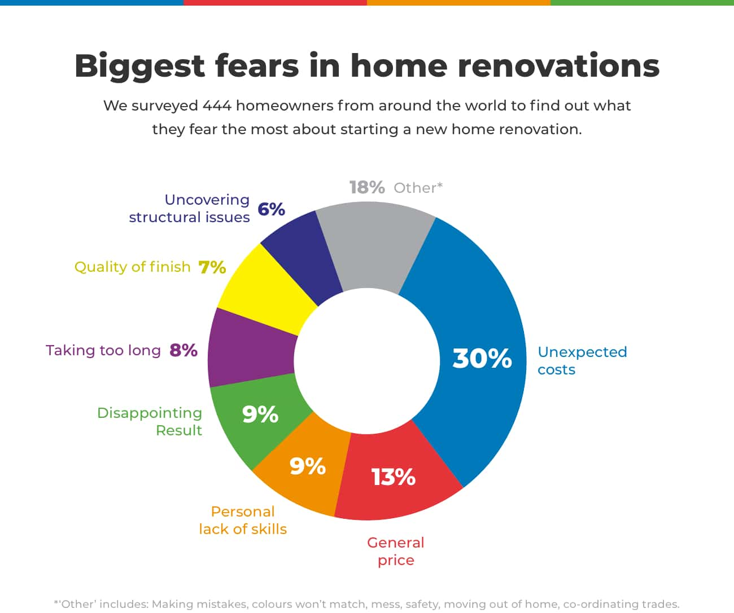

Young homeowners and first-time renovators
Part of the millennial generation looking for smart homes and appliances⁶
Time-poor and cost-conscious
Pain points:
Cost ^{3,4}
Quality ⁴
Reliability
Age: 25-40 years old¹
Median household income²
Part of the 50% of Australian homeowners planning on minor renovations in the next year ⁵
Notes:
Martha
With home ownership rates declining over the years, young buyers have been stretching their finances to be able to afford a house³.

Slide 3



Targeted advertisements
Social media: Facebook and Instagram⁷
Targeting new homeowners and people Googling: “painting supply store near me”, “How much does it cost to renovate my kitchen”
Notes:
To enhance Digital presence of the company, We should begin with advertising on Instagram, Facebook and Google. By focusing on these platforms only out of the rest, we could generate maximum possible leads, revenue and digital presence in least possible time if the advertisements are displayed to the targeted audience in the targeted areas consistently throughout the period decided beforehand.
^graph of millennial social media use?

Slide 4

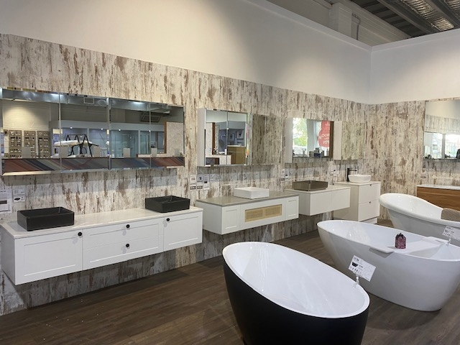
Business partnerships
Collaborations with appliance stores/manufacturers.
  Hardware items could be sold with stickers on it, saying ‘Free Installation’ from LocalTasker
  Mutually beneficial agreement to be struck on the management level with the hardware company.
Partnerships with developers and property managers, who advise clients to go to LocalTasker for their maintenance needs
Buy today and receive complementary installation from a LocalTasker expert!
Notes:
Collaborations could be made with big hardware companies. Hardware items could be sold with stickers on it, saying ‘Free Installation’ from Local Tasker, though the revenue deal could be struck on the management level with the hardware company. This way all the parties involved could benefit.
Partnership deals could be struck with Constructors, Small and Big landlords, which would fetch more business for Local Tasker.
A deal could be made with Hardware stores as well, who could offer to provide cheap installations to their customers through local tasker. (This option is a substitute for 1st option, in case a deal cannot go through with the big players)

Slide 5
Enhancements to app/website
Personalization
  Location-based service filtering so users see contractors closest to them.
  AI chatbot for simple questions
Ratings, reviews, and profiles
  90% of millennials are more inclined to purchase from a brand with verified reviews⁸
  Customer testimonials
  Portfolio of the contractor’s work
  Price transparency/estimate on profiles
  Verified contractor and customer profiles
Extra features
  Auto translate feature
  One-click booking and real-time task updates (ex, “Tasker on the way,” status notifications)
Notes:
Use research from the persona to incorporate price transparency and reliable service verification into the app
Goal:
To make app convenient, trustworthy, and reliable (addressing the target market’s fears)

Slide 6
Conversion funnel
Targeted Ads, Social Media, Partnerships
Website Visit, App Browse, Reviews
Quote, Info, “Book Now”
Fast Checkout, Payment
Awareness
Consideration
Decision
Action
Reviews, Loyalty Programs, Rebooking Reminders
Retention
Notes:
Zidane- can you incorporate measurable targets (e.g., 25% increase in leads, reduced bounce rates). Can talk about this in the presentation instead of putting it on the slide

Slide 7
Resources
1. https://www.ahuri.edu.au/analysis/brief/when-are-australians-buying-their-first-home
2. https://www.abs.gov.au/statistics/labour/earnings-and-working-conditions
3.https://www.aph.gov.au/About_Parliament/Parliamentary_departments/Parliamentary_Library/Research/Issues_and_Insights/48th_Parliament/Implicationsofdeclininghomeownership#:~:text=Since%20peaking%20at%2071%25%20in,from%2061%25%20to%2043%25.
4. https://www.refreshrenovations.com.au/articles/biggest-renovation-fears-study
5. https://www.comparethemarket.com.au/news/renovation-nation-52-of-homeowners-plan-to-spruce-up-their-digs-next-year/
6. https://www.samsung.com/us/business/builder/industry-innovation/insights/millennial-homebuyers-remorse-what-designers-need-to-know/
7. https://review.content-science.com/millennial-content-consumption-fact-sheet/#:~:text=Millennials%20are%20likely%20to%20connect,reading%20a%20social%20media%20review.
8. https://media.sproutsocial.com/uploads/Sprout-Social-The-Digital-Natives-Report.pdf

